Slide 1
Qualcomm Demos
Meeting of the Minds
October 10, 2012

Slide 2
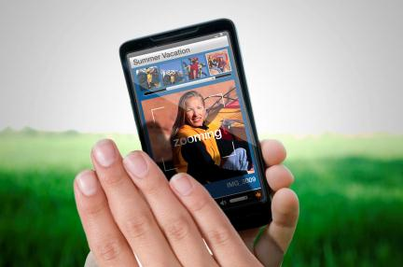
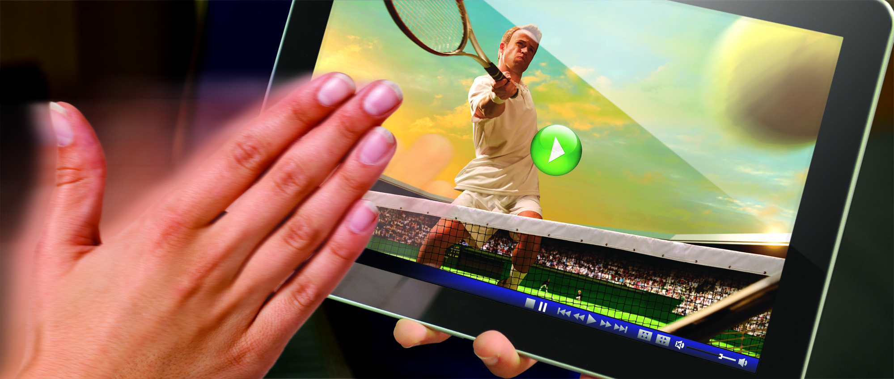
Camera Gestures
The swipe of your hand or a turn of your head delivers a new user experience with hands-free device and application control
S4 processor leverages camera, ultrasonic sound, infrared light to detect gestures

Slide 3


Wi-Fi Display
Enabling a broad ecosystem of Wi-Fi Display solutions, allowing customers to deliver fun/easy content sharing from device to device
Support a new class of end-user applications including smartphones and tablets
S4 processors integrate Bluetooth, 3G/4G LTE and Qualcomm’s Wi-Fi technology to address all the connectivity needs of smart devices
Major Elements of Wi-Fi Display
Major Elements of Wi-Fi Display Standard
802.11n Wi-Fi Direct
Mandatory - H.264 Video Compression
Mandatory - LPCM Audio Codec
Mandatory - MPEG 2 TS Defined Transport Layer
Optional - Content Protection (HDCP 2.0/2.1)
Optional – User Input Back Channel (UIBC)

Slide 4
High Efficiency Video Code (HEVC)
Upcoming video compression standard that brings significant efficiency in data compression
40% more data efficient than H.264
Future Snapdragon processors will incorporate HEVC support
Planning for 2013 release of HEVC standard

Slide 5
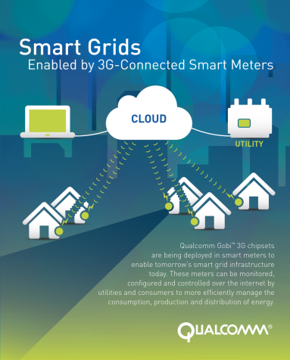
Smart Energy
Dollar for dollar, the total cost of ownership for smart meter deployment is very competitive using a 3G network
The same advanced communications and computing technologies used in billions of devices are driving more reliable, secure and cost-effective smart grids and intelligent homes
Qualcomm Gobi chipsets enable an ecosystem of advanced cellular solutions for an IP enabled smarter grid

Slide 6
Thank you

Slide 7
声明：
所有的版权属于原有公司，文件均来自公开渠道
此文件仅供学习使用，任何人不得进行以此为商业目的的行为
如有疑问，请立即删除
学习世界五百强和咨询公司PPT课程请访问如下网站搜索：“司马懿”
百度传课：司马懿PPT学校
https://www.chuanke.com
网易学堂：司马懿PPT学校
https://study.163.com
知乎： 司马懿PPT学校
https://www.zhiu.com

